Slide 1
Using Data Science in Biotech and Drug Discovery
Presented by Nicholas Jones (DSNow #9)
Disclaimer: NOT Investment advice

Slide 2
Why I chose this topic
I am Highly passionate about Biotech
I believe that drug discovery is one of the most important factors in enhancing and saving lives
Despite this… Biotech is one of the hardest sectors to evaluate...
Intrinsic value of a company is arbitrary due to drug failure risk
Biotech companies are mostly pre-revenue micro to small cap companies- making traditional financial evaluation a bit tricky

Slide 3
What is Biotech
Usually Pre-Revenue companies
focused on drug discovery and development
Need to pass 4 clinical phases to achieve approval: Pre-clinical, phase 1, phase 2, and phase 3
This usually requires extensive clinical trials that require statistically significant outcomes to be approved by the Federal drug administration

Slide 4
How Do Clinical Trials Work?
Preclinical Trialing based on animal studies- generally DIO mice, rhesus macaques, and cynomolgus macaques
Phase 1- Start of Human trialing (Safety/AE profile very important in this phase)
Phase 2- More extensive trialing (AE profile still very important- efficacy begins to become more of a concern)
Phase 3- Most extensive trail- (Primary Endpoint very important, Serious AE’s very important, less room for Post-HOC analysis for approval- generally)
After achieving Phase 3 success, the company applies for an NDA… If approved, they are more easily able to start achieving cash flow/ revenue enhancing their business model
Usually 1-6 years
Preclinical Trialing
Several Months
Phase 1
Several Months- 2 Years
Phase 2
1-4 Years
Phase 3

Slide 5
Data Science in Drug Discovery, Development and Patient Treatment (Literature Review)
Article: “Artificial Intelligence (AI) Applications in Drug Discovery and Drug Delivery: Revolutionizing Personalized Medicine” by NIH National Library of Medicine (National Center for Biotechnology Information)
Data Science/ Machine Learning applications have been used in drug discovery since as early as the 1980’s and 1990’s through basic computational models and chemical structure prediction
In the 2000’s “A.I.” (Data Science) began to grow in its power through machine learning algorithms capable of analyzing complex datasets, streamlining drug discovery processes and predicting molecular interactions
Widespread adoption of Machine Learning/ A.I. took off in 2010’s “driven by advances in Big Data, deep learning, and access to large biological and chemical datasets… various stages of development , from target identification to clinical trial design.”
“AI has encompassed a wide range of techniques that have been applied by pharmaceutical companies over the last few decades, including machine learning, deep learning, and other advanced computational techniques”
“…resulted in unprecedented opportunities for the expedition of the drug discovery and drug delivery processes, leading in turn to the optimization of treatment regimens and the improvement of patient outcomes”
“AI algorithms can analyze large-scale biomedical data uncovering hidden relationships between drugs and diseases. ”
https://pmc.ncbi.nlm.nih.gov/articles/PMC11510778/#sec2-pharmaceutics-16-01328

Slide 6
Data Science in Biotech Equity Evaluation
Long discovery/clinical timelines and binary drug outcomes can cause a drought of funding- not based necessarily on the drug company or compound itself, but based on the markets ability to accurately evaluate that company/compound
This can sometimes cause a lack of funding in Biotech: most recently (2021- 2025)
Companies may have to forgo drug development because of lack of funding rather than the drugs efficacy and safety profile
Drug development may be hindered by the markets lack of confidence in evaluating drug success probabilities
Data Science modeling methods that can give equity evaluators the tools necessary to assess drug approval probabilities
Enhancing drug discovery capabilities for investigational drugs and the equity evaluators that provide funding

Slide 7
Synergy of Accurate Equity Evaluation and Successful Drug Projection Models In Enhancing Clinical Outcomes
By using Data Science to create more accurate clinical projection models during drug discovery and clinical trials…
Companies are more informed in what MOAs and Indications thereof are more likely to succeed in clinical trials and the real world
Equity evaluators are more likely to also use these Data Science methods and be more confident in their investments into drug discovery
Making drug discovery and clinical trialing a more effective and well funded endeavor
Theoretically enhancing and saving more lives by advancing medicine

Slide 8
Example of Equity Evaluation: Where Data Science Steps In
Abivax (ABVX)

Slide 9
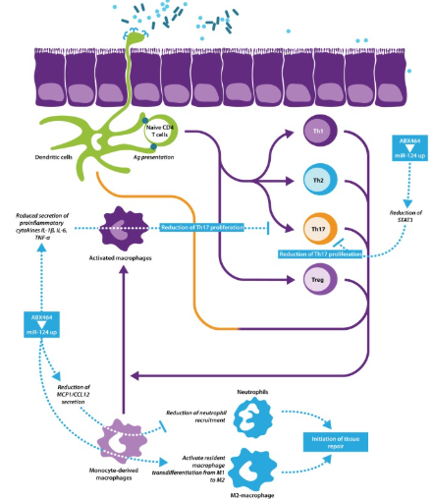
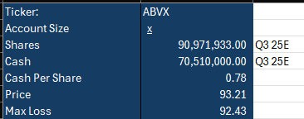
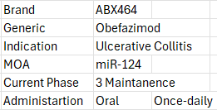
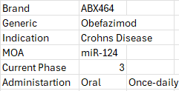
Abivax Overview
https://www.sciencedirect.com/science/article/pii/S1359644620305377

Slide 10
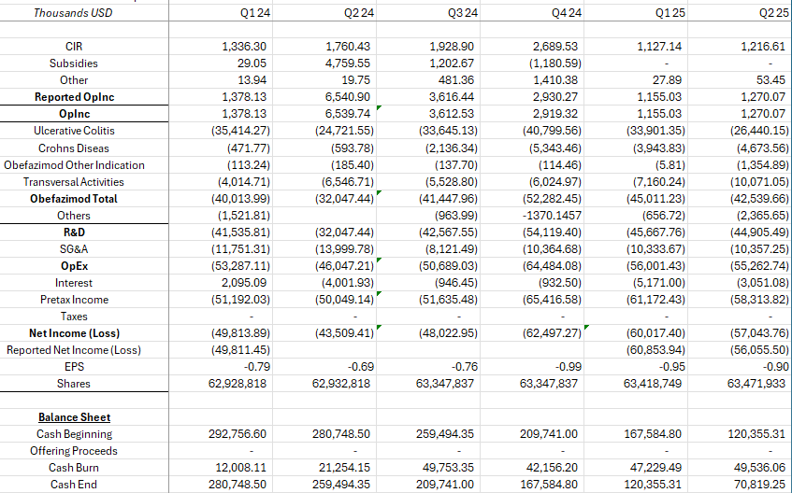
ABVX: Pre- Revenue
Biotech company business model before drug on the market
Losing money each quarter = cash burn
Business model is dependent on drug approval in 2nd quarter data release in 2026
Evaluation also dependent on projecting clinical success

Slide 11
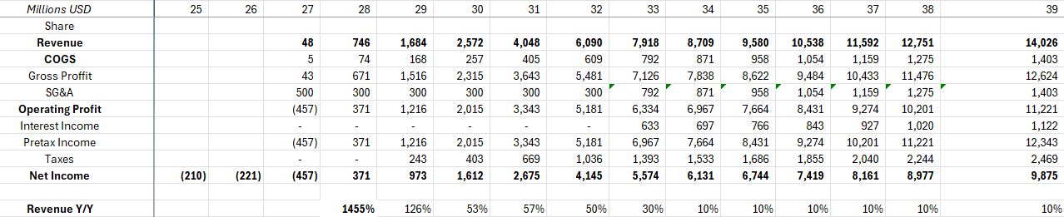
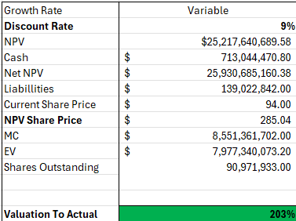
Post Approval Company Model
Based on drug comparison
Post launch for Obefazimod if approved in 2nd quarter of 2026
Very rough estimates here
Need more time to pinpoint… Just an idea of what the launch would modestly look like

Slide 12
Where Data Science Steps In
Hopefully, this gives an idea of how you can use data science to model clinical success probabilities
This provides the investor an idea of the risks and potential npv
Cash flows for company dependent on approval of data
So based on data science modeling, equity evaluators can project the probability of success of a clinical trial
Then assess the financial situation of the company and determine if the risk to reward is worth the investment
Giving equity evaluators a clear guideline for drug discovery
Currently working on model for the UC trial was hoping I would finish in time, but I have not

Slide 13
Thank You For Listening
Contact Info:
Nicholas Alexander Jones
nickjones@smu.edu
SMU MSDS student

Slide 14
Citations
https://ir.abivax.com/financial-information/sec-filings
https://pmc.ncbi.nlm.nih.gov/articles/PMC11510778/#sec2-pharmaceutics-16-01328
https://www.sciencedirect.com/science/article/pii/S1359644620305377

